Slide 1
TELECOM CHURN PREDICTION

Slide 2
Churn is the measure of how many customers stop using a product. This can be measured based on actual usage or failure to renew (when the product is sold using a subscription model). Often evaluated for a specific period of time, there can be a monthly, quarterly, or annual churn rate.\
For Telco companies it is key to attract new customers and at the same time avoid contract terminations (=churn) to grow their revenue generating base. Looking at churn, different reasons trigger customers to terminate their contracts, for example better price offers, more interesting packages, bad service experiences or change of customers’ personal situations..

Slide 3
Step 1: Problem Definition
Step 2: Data Collection
Step 3: Exploratory Data Analysis (EDA)
Step 4: Feature Engineering
Step 5: Train/Test Split
Step 6: Model Evaluation Metrics Definition
Step 7: Model Selection, Training, Prediction and Assessment
Step 8: Hyperparameter Tuning/Model Improvement

Slide 4
Problem Definition
The business objective is to predict the churn in the last (i.e. the ninth) month using the data (features) from the first three months. To do this task well, understanding the typical customer behaviour during churn will be helpful.

Slide 5
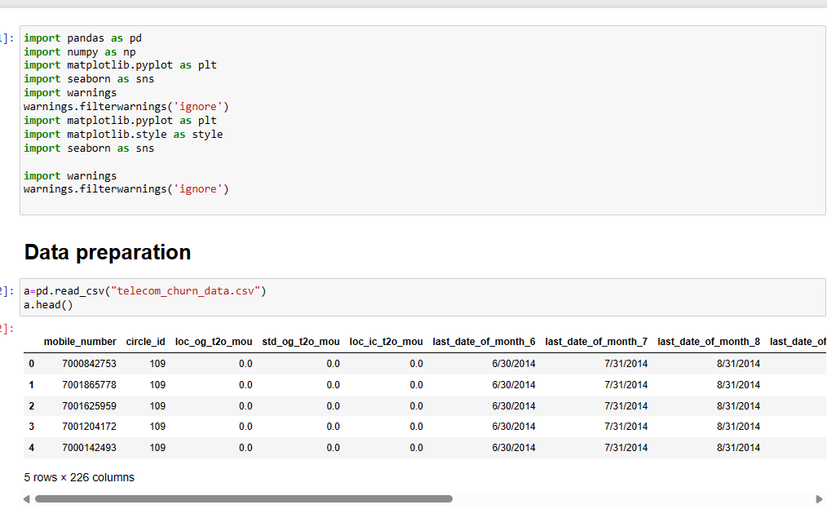
Data Collection

Slide 6
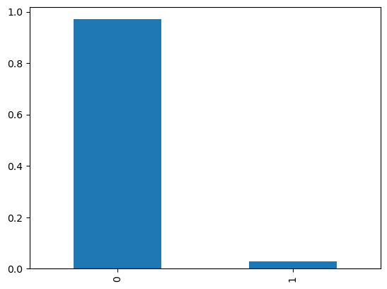
Exploratory Data Analysis (EDA)
Churn count as 1 and Not Churn as 0

Slide 7
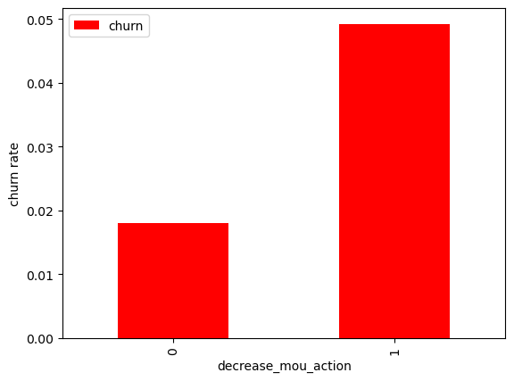
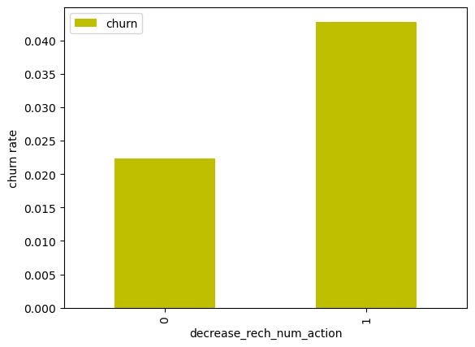
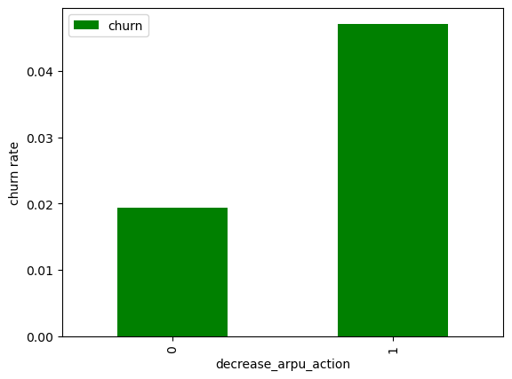
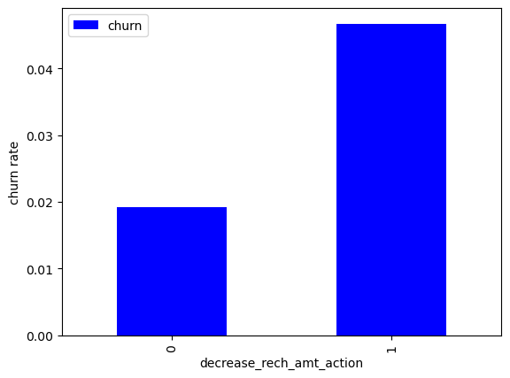
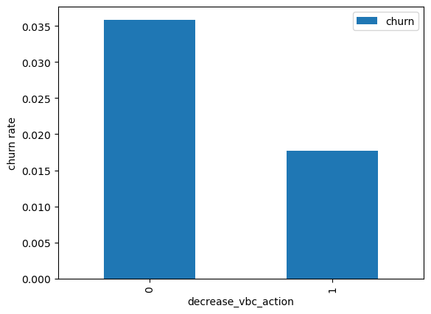

Slide 8
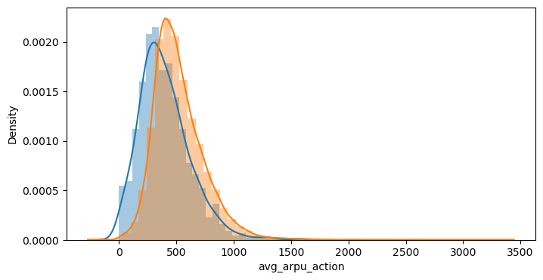
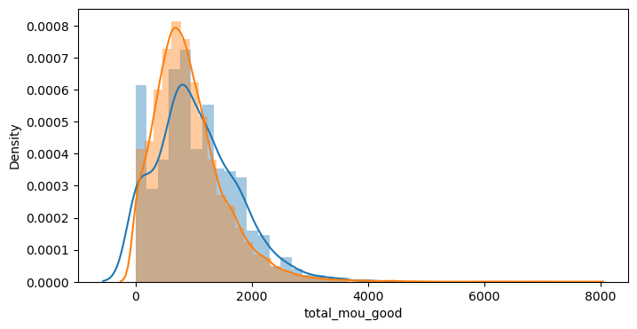
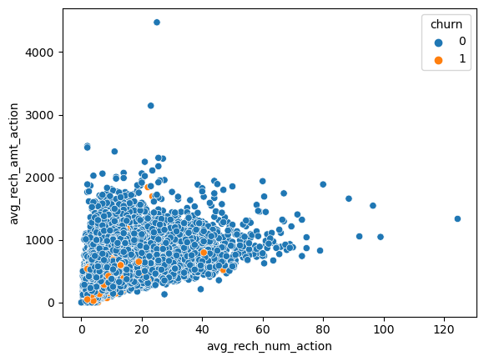
#Recharge amount and number of recharge in action month

Slide 9
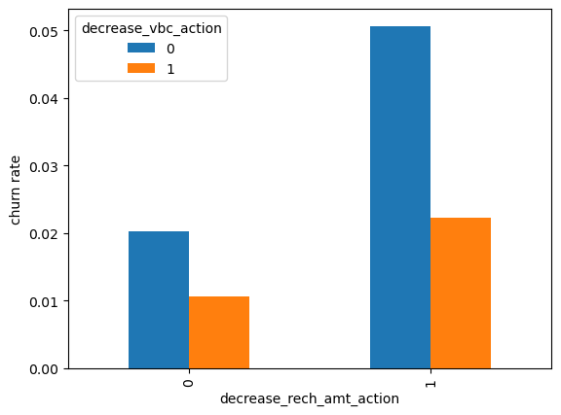
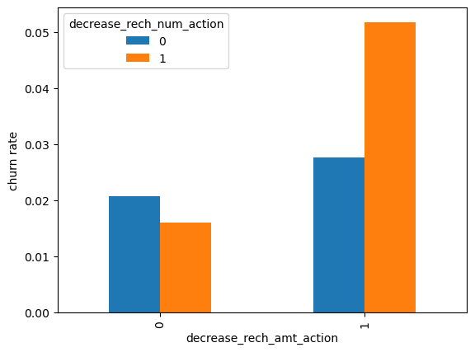
#churn rate by the decreasing recharge amount and volume based cost in the action phase
#churn rate by the decreasing recharge amount and number of recharge

Slide 10
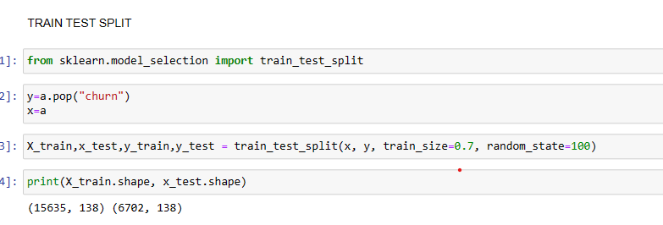
Train/Test Split

Slide 11
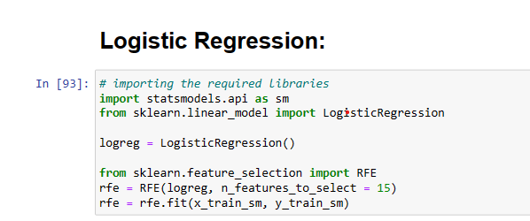
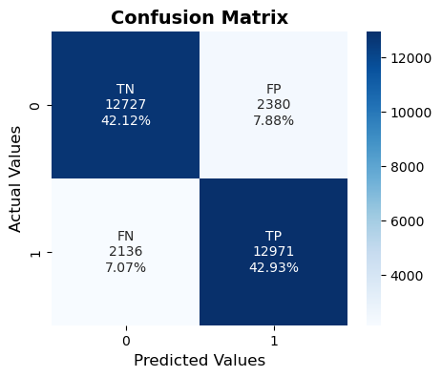
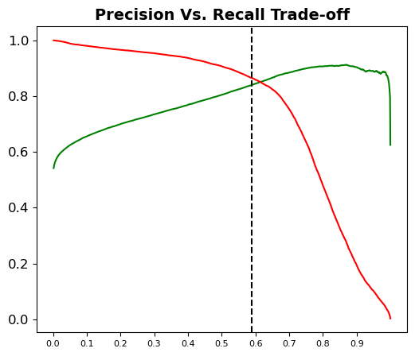
MODEL PREPARATION

Slide 12
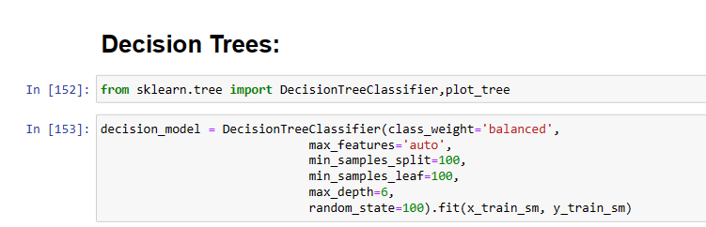
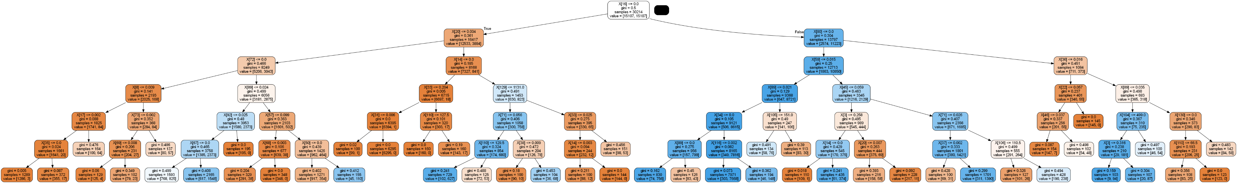

Slide 13

ALL 3 MODEL HAVE SHOWED A GREAT ACCURACY VALUE.
Important features on which models were build:

